Slide 1
Notes:
Everyone is in the business of selling products. Not necessarily sold for monetary value but for impact.

Slide 2

Notes:
The product may be this boot camp experience, maybe the product is enthusiasm for data science,

Slide 3

Notes:
or perhaps in our own case, the product to sell is our own value to potential employers we are selling our value to potential employers.

Slide 4







Notes:
Consider the fact that everyone in this room either has held or will hold positions for companies that sell products. The best strategy for sell a product is design optimization.

Slide 5

Feedback Classifier Brooke Ann Coco
Notes:
Introduce name
The goal of this project is to utilize unsupervised machine learning to classify product reviews, enabling developers and designers to improve their product.

Slide 6
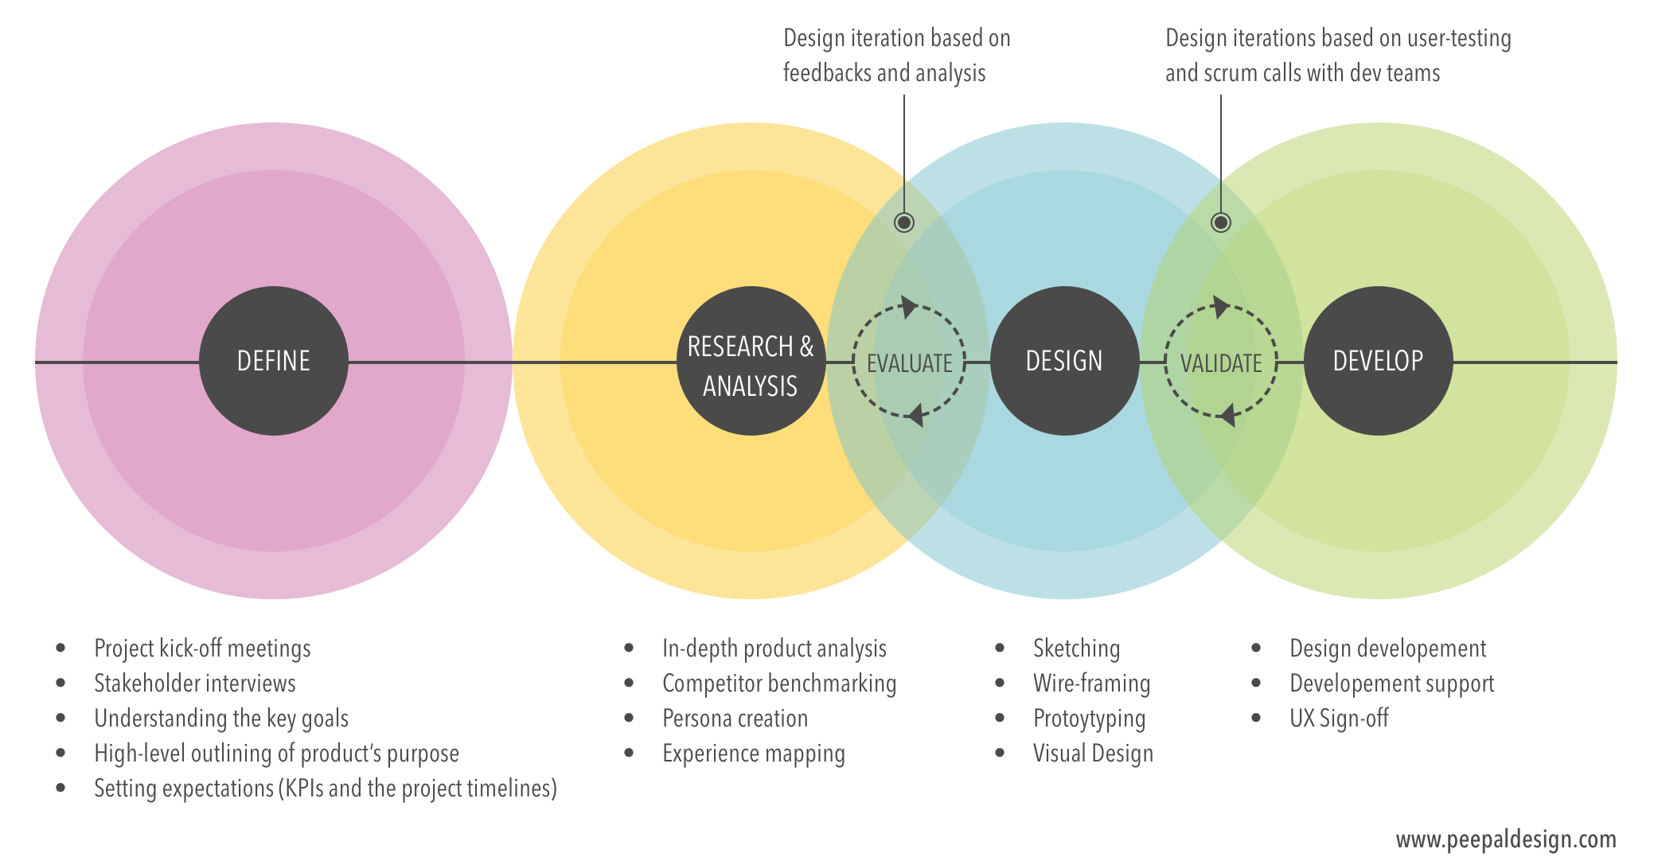
Notes:
Developers and designers optimize their products through an iterative process, which is pictured here.
Define product
Identify business goals
Define metric for success
Establish project timeline
Conduct research and analysis
Product analysis
Define target audience
User research
Surveys and interviews
Benchmarking competitors
Design
Map out end-to-end experience and sketch
Sketch each step
Prototypes
Test
Usability studies
Focus groups
Diary studies
Interviews
Workshops
Develop and test until deployment

Slide 7
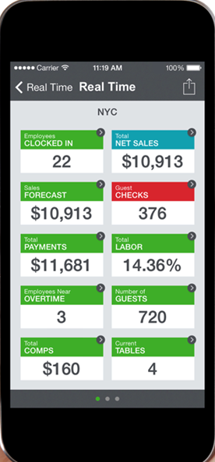
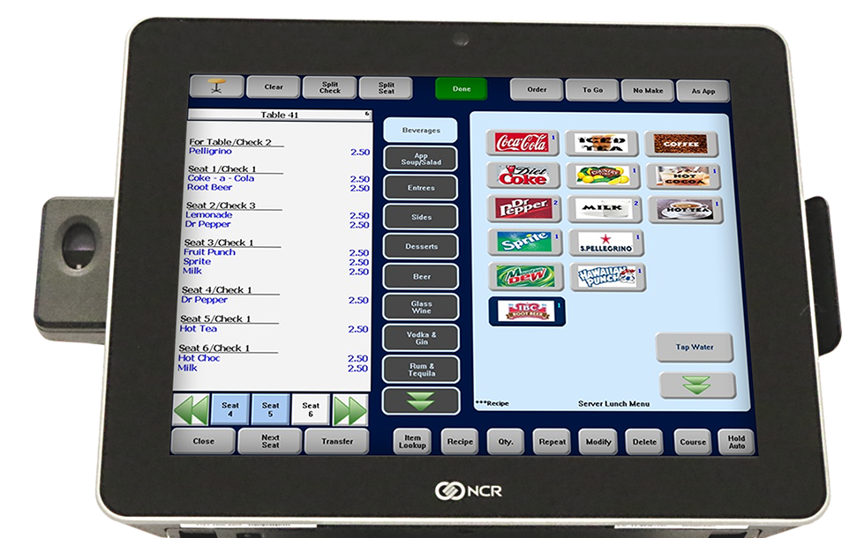
Point-of-sale (POS) Systems
Notes:
Now because I do not have access to the user research collected by private companies, I turned to online reviews
Restaurant POS systems are central to functioning of many restaurants
Management
Payroll and labor management
Sales, inventory, and customer analytics
Servers
Communicates orders to the back of the house
Processes payments

Slide 8
Methodology
Scrape Data
G2
Capterra
Clean Data
Lower
Expand contractions
Spell check
Stemming
Lemmatization
Notes:
Methodology
Scrape Data
G2
GetApp
Clean Data
Lower
Expand contractions
Spell check
Stemming
Lemmatization
Tokenize
By sentence
Vectorize
TF-IDF
Dimensionality Reduction
NMF
Cluster
K-Means

Slide 9
Scrape Data
G2
Capterra
Clean Data
Lower
Expand contractions
Spell check
Stemming
Lemmatization
Methodology
Notes:
Methodology
Scrape Data
G2
GetApp
Clean Data
Lower
Expand contractions
Spell check
Stemming
Lemmatization
Tokenize
By sentence
Vectorize
TF-IDF
Dimensionality Reduction
NMF
Cluster
K-Means

Slide 10
Tokenize Data
By sentence
Vectorize Data
Term Frequency-Inverse Document Frequency
Dimensionality Reduction
Non-Negative Matrix Factorization
Cluster Data
K-Means Clustering
Methodology
Notes:
Methodology
Scrape Data
G2
GetApp
Clean Data
Lower
Expand contractions
Spell check
Stemming
Lemmatization
Tokenize
By sentence
Vectorize
TF-IDF
Dimensionality Reduction
NMF
Cluster
K-Means

Slide 11
Methodology
Tokenize Data
By sentence
Vectorize Data
Term Frequency-Inverse Document Frequency
Dimensionality Reduction
Non-Negative Matrix Factorization
Cluster Data
K-Means Clustering
Notes:
Methodology
Scrape Data
G2
GetApp
Clean Data
Lower
Expand contractions
Spell check
Stemming
Lemmatization
Tokenize
By sentence
Vectorize
TF-IDF
Dimensionality Reduction
NMF
Cluster
K-Means

Slide 12
Tokenize Data
By sentence
Vectorize Data
Term Frequency-Inverse Document Frequency
Dimensionality Reduction
Non-Negative Matrix Factorization
Cluster Data
K-Means Clustering
Methodology
Notes:
Methodology
Scrape Data
G2
GetApp
Clean Data
Lower
Expand contractions
Spell check
Stemming
Lemmatization
Tokenize
By sentence
Vectorize
TF-IDF
Dimensionality Reduction
NMF
Cluster
K-Means

Slide 13
Tokenize Data
By sentence
Vectorize Data
Term Frequency-Inverse Document Frequency
Dimensionality Reduction
Non-Negative Matrix Factorization
Cluster Data
K-Means Clustering
Methodology
Notes:
Methodology
Scrape Data
G2
GetApp
Clean Data
Lower
Expand contractions
Spell check
Stemming
Lemmatization
Tokenize
By sentence
Vectorize
TF-IDF
Dimensionality Reduction
NMF
Cluster
K-Means

Slide 14
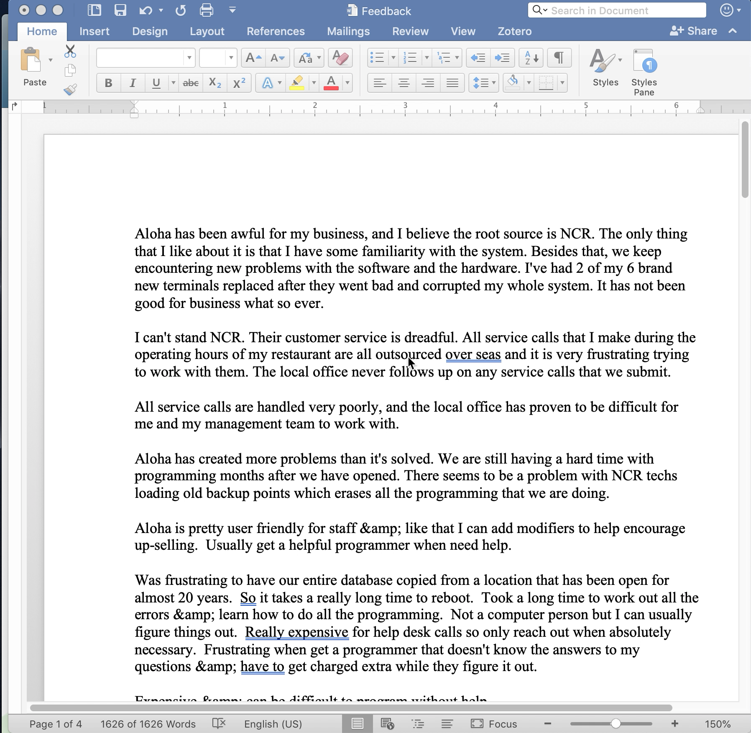
Results
Notes:
Category 0: User-friendly
Category 1:
Category 2: Ease of Use
Category 3: Cost/ Price
Category 4: customer service

Slide 15
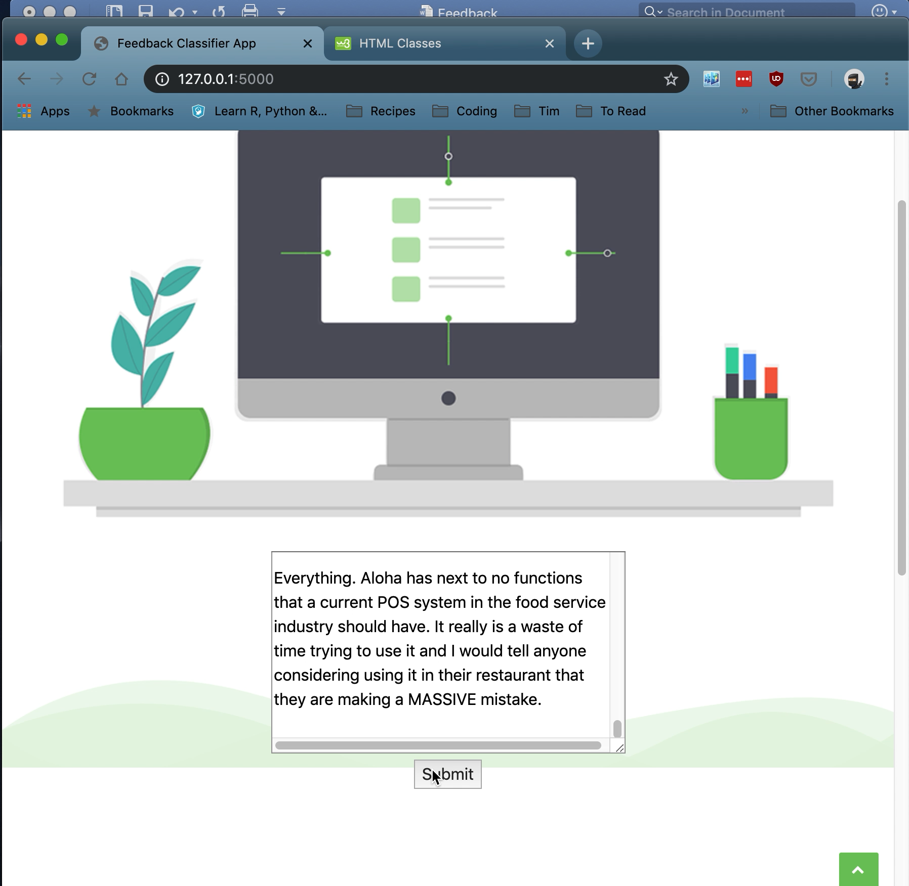
Results
Notes:
Category 0: User-friendly
Category 1:
Category 2: Ease of Use
Category 3: Cost/ Price
Category 4: customer service

Slide 16
Future Work
Parse reviews based on prompt
Word embeddings
Display original, pre-processed review
Generalize model
Notes:
Parse reviews based on prompt
Use it to train a sentiment analyst
Word Embeddings
People use different terms to refer to similar concepts the model has a hard time picking that up
Customer support and customer service
Different models
Display original, pre-processed review
Generalize to other products

Slide 17

Questions?

